Slide 1
Customer Segmentation
DCS-680
Project 3

Slide 2
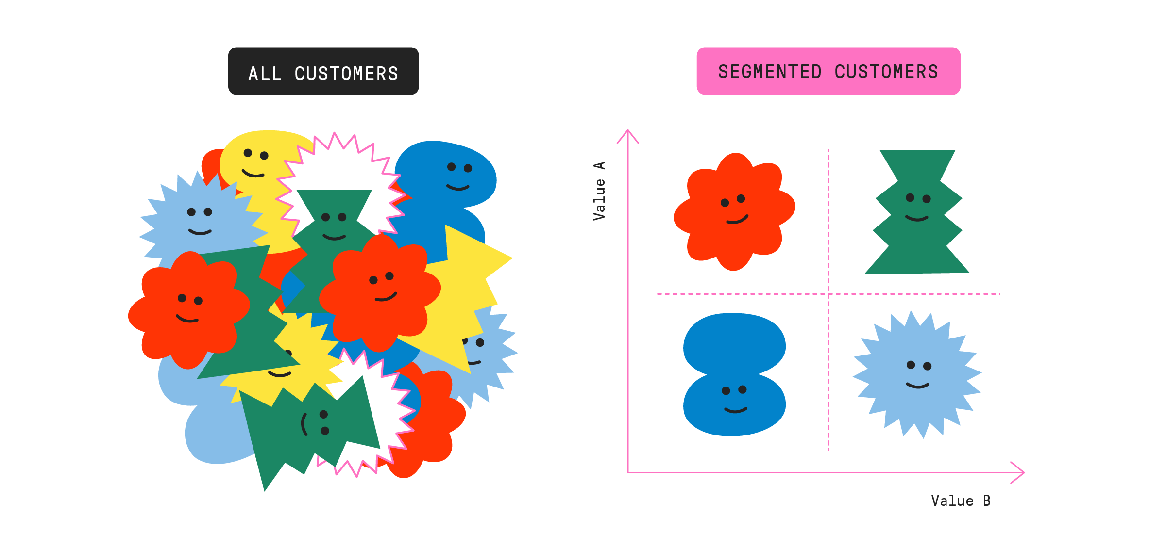
Why this?
Customer segmentation is a process which allows a business to divide their customer base into specific groups based on similarities such as gender, age, shopping habits, and more. Using machine learning algorithms, I plan to segment customers of a shopping mall in this manner.

Slide 3
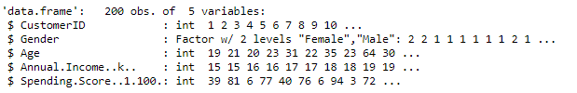
Data Exploration
We have around 200 rows and 4 features
Age
Annual Income
Spending Score
Gender

Slide 4
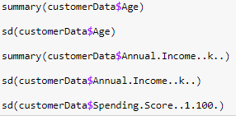
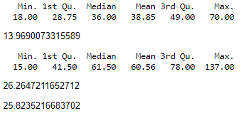
Data Exploration
summary() and sd()

Slide 5
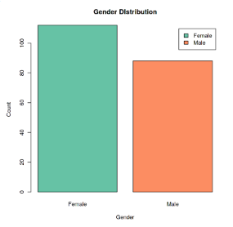
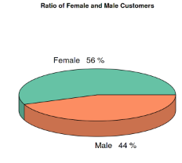
Visualizations

Slide 6
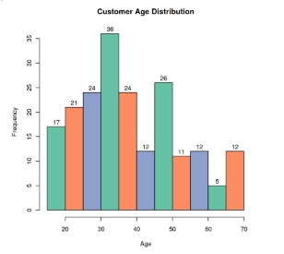
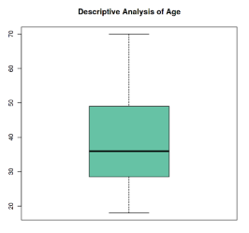
Visualizations

Slide 7
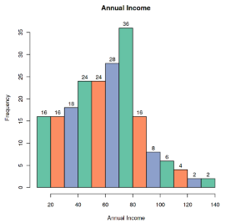
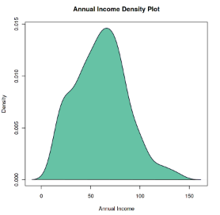
Visualizations

Slide 8
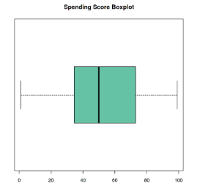
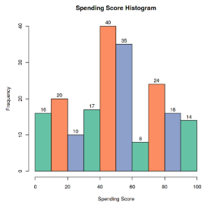
Visualizations

Slide 9
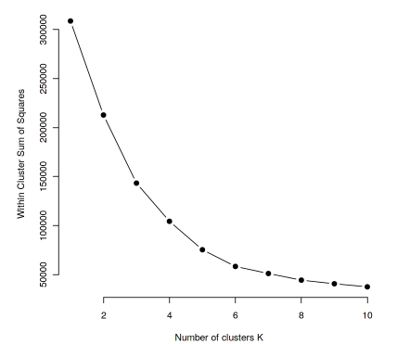
K means cluster analysis (Elbow Method)

Slide 10
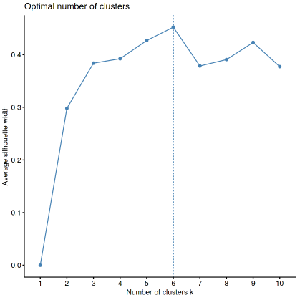
Silhouette Analysis Plot

Slide 11
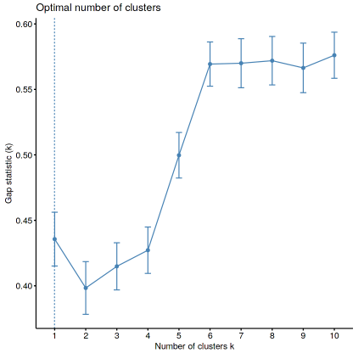
Gap Statistic

Slide 12
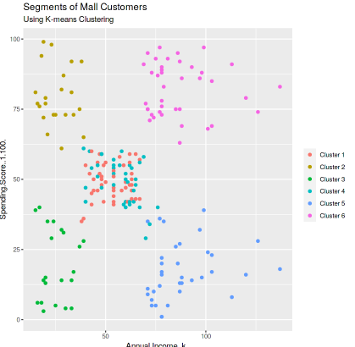
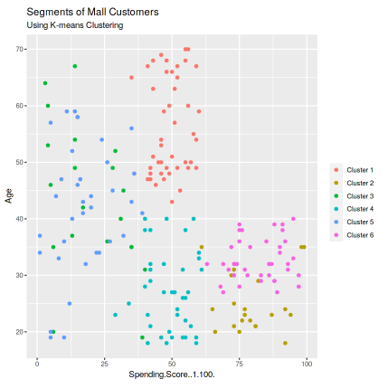
Visualizing K-means

Slide 13
The End

